Slide 1
Azure Machine Learning Studio: Making Data Science Easy(er)
October 19th, 2019
Brad Llewellyn
Data Analytics Architect
Microsoft

Slide 2
The views expressed during this presentation may not represent the official views of Microsoft or the FastTrack for Azure team.

Slide 3





MCSE: Data Management and Analytics
MCSE: Cloud Platform and Infrastructure
MCSA: Machine Learning
MCSA: SQL 2016 BI Development
MCSA: SQL 2016 Database Development
MCSA: SQL Server 2012/2014
MCSA: Cloud Platform
MC: Azure Data Engineer Associate
M.S. Statistics: University of South Carolina
Analytics Consultant – 7 Years
Microsoft – 1 Year
Brad Llewellyn
Data Analytics Architect
(Service Engineer – FastTrack for Azure)
Microsoft
@BreakingBI
https://www.linkedin.com/in/bradllewellyn
http://breaking-bi.blogspot.com
Llewellyn.wb@gmail.com
Organizer – Charlotte BI Group – http://charbigroup.com
Member and Speaker – PASS – http://www.pass.org

Slide 4



https://www.pass.org

Slide 5
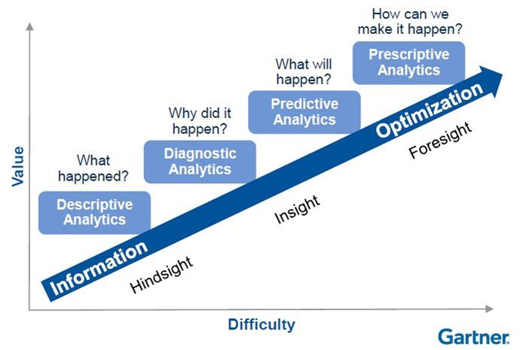
What is Data Science?
Data
Science
Advanced
Analytics

Slide 6



Agenda
What is Microsoft Azure?
Why Azure Machine Learning Studio?
Demo!!!

Slide 7
What is Microsoft Azure?
Analytics at Cloud Scale

Slide 8

What is Microsoft Azure
Cloud Infrastructure, Data Platform and Computing
Enterprise Grade
Managed and Supported by Microsoft

Slide 9
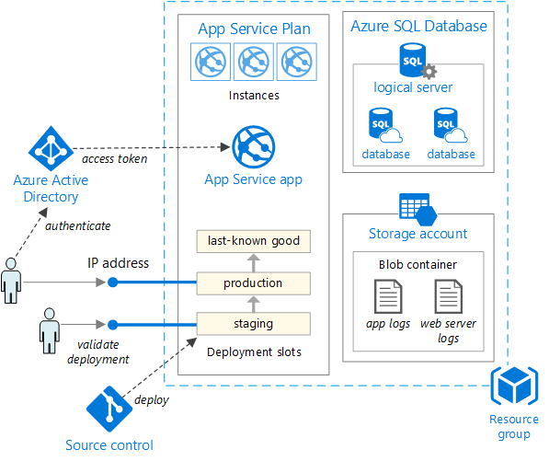
What Can We Build With Azure?
Virtual Machines
Virtual Networks
Databases
Storage
Applications
Open-Source
…

Slide 10
Why Azure Machine Learning Studio?
Machine Learning for the Data Professional

Slide 11

Common Data Science Struggles
Steep Learning Curve and Code-Heavy Tools
Development, Testing and Optimization and Time-Consuming
Requires Heavy Knowledge of Statistical Techniques
Productionalization Can Be Time-Consuming and Expensive

Slide 12

What is Azure Machine Learning Studio?
Cloud Computing SaaS
Popular, Well-Documented Algorithms
Easily Accessible to Data Professionals
Code-Free GUI
(if you want it to be)
Easily Integrates into Enterprise Data Structure

Slide 13
Demo!!!
Show me the money!

Slide 14
What are you waiting for?
Step 1: Create a Free Workspace
Step 2: Find Quick Solutions to Your Organization’s Problems
Step 3: Become the Boss!
Step 4: Tell Your Friends!

Slide 15

Brad Llewellyn
Data Analytics Architect
Microsoft
@BreakingBI
https://www.linkedin.com/in/bradllewellyn
http://breaking-bi.blogspot.com
Llewellyn.wb@gmail.com

